Slide 1
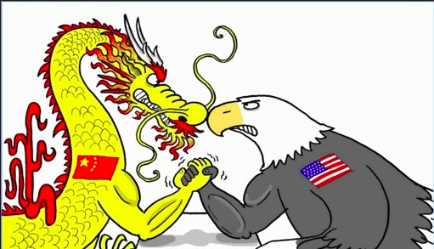
CHINA VS. AMERIC
Who is more Educated!
Zhaohan Yan(172008944)

Slide 2

Back Ground
The United States is known as the top country in terms of technology and economic power in the whole wide world.
China is known as the Lion that waked up.China is one of the fastest developing country in the world right now. Facts researcher
Claim China will soon take place America’s No.1 position.
Comparing them In terms of education who will win?

Slide 3
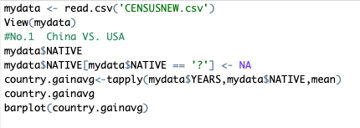
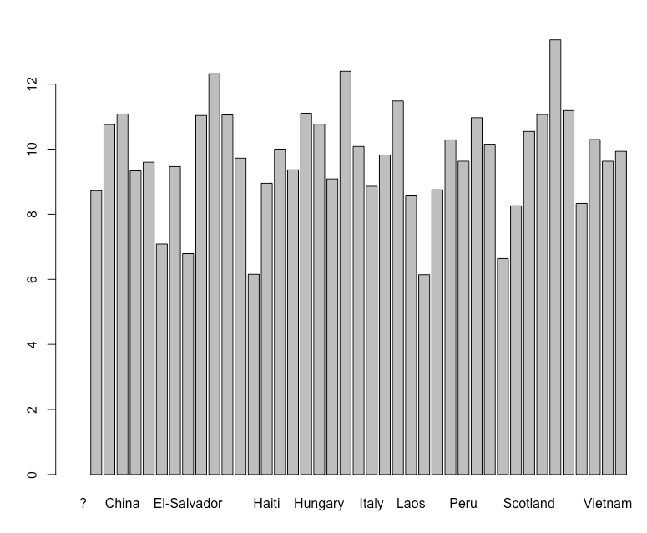
Data Prepare
This code used to clean up the data and calculated the mean years of study for each country to have a brief idea of how’s the education situation in the whole wide world

Slide 4
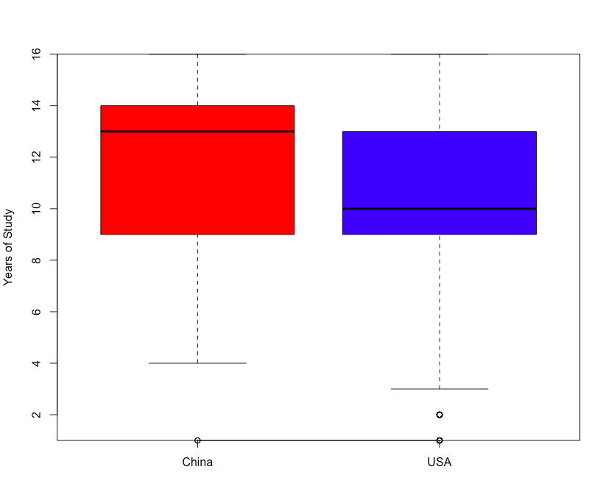
Comparing China VS. America
This box plot shows hat Chinese tend to have a longer years of education comparing to Americans
Bsed on that graph, my hypothesis is :
#CHINESES have better education than AMERICANS
Null Hypothesis is :
CHINESE HAS SAME EDUCATION AS AMERICANS

Slide 5
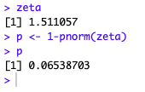
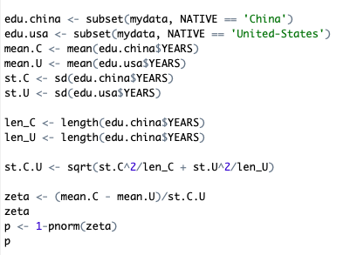
Result: Z-test and P value
After running the z-test we got
zeta value: 1.511057
P value: 0.06538703

Slide 6
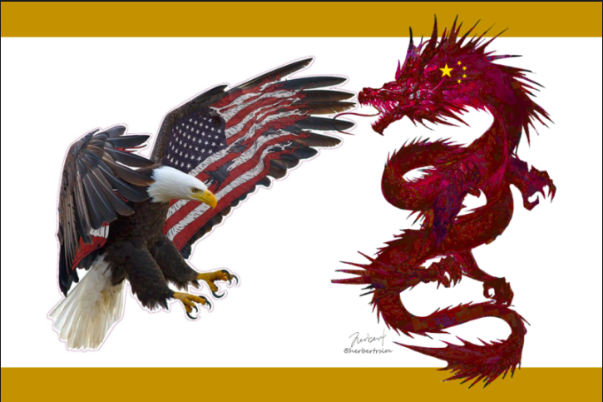
The result
Since I got a A large p-value (> 0.05) here which indicate weak evidence against the null hypothesis, so you fail to reject the null hypothesis. So there is not enough evidence to prove Chinese have a better education than Americans.
In the future:
To prove my hypothesis is true I need to expand my dataset,
BTW, Hope two country compete in a good and peace way!

Slide 7
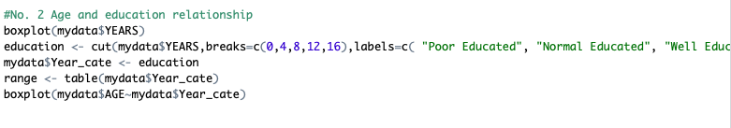
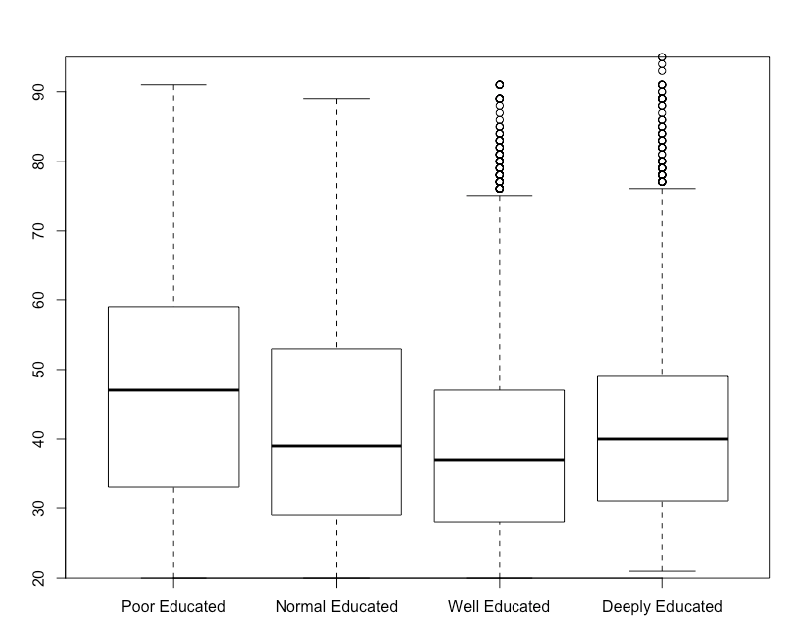
No.2: Age and Education
My second interested hypothesis is toward the relationship between Age and Education. I seperated people into 4 groups based on number of years they got educated.

Slide 8
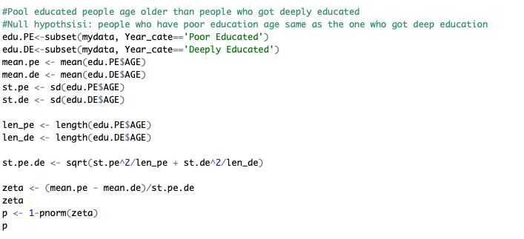
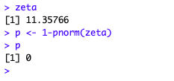
Hypothesis and running the z-test
Zeta : 11.35766
P : 0

Slide 9

Result
A small p-value (typically ≤ 0.05) indicates strong evidence against the null hypothesis, so you reject the null hypothesis. Which means it is highly likely that my hypothesis: Pool educated people age older than people who got deeply educated is true.

